Slide 1
Welcome
National Symposium
Sepsis Clinical Care Standard
Stopping Sepsis National Action Plan
MC A/Prof Naomi Hammond

Slide 2
Thank you

Slide 3
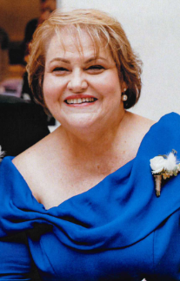
In memorium
Adj Prof Kathy Meleady PSM
23 Oct 1958 – 13 Aug 2022

Slide 4
Overview and Objectives
A/Prof Naomi Hammond

Slide 5
Symposium overview and objectives
Symposium information sheet
Objective 1: Sepsis Clinical Care Standard
Requirements, implementation resources
and examples of best practice
Objective 2: Stopping Sepsis National Action Plan
5 year strategic objectives.

Slide 6
Sepsis 2022
Prof Simon Finfer AO

Slide 7
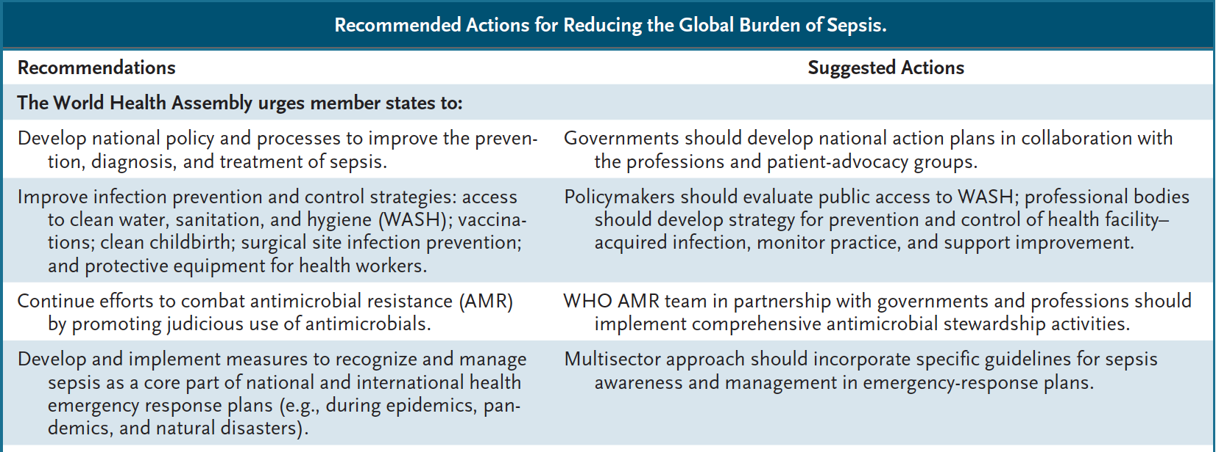
Sepsis 2017

Slide 8
Sepsis 2020
In 2017:
Global – 49 million cases, 11 million associated deaths
Australia – 55,000 cases, 8,700 deaths

Slide 9
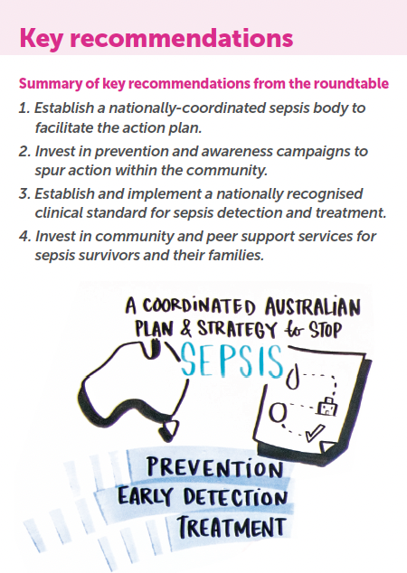
Australia
December 2017

Slide 10
Australia
December 2017
June 2022

Slide 11
Sepsis Clinical Care Standard
Dr Alice Bhasale

Slide 12
Sepsis Survivors, Families, Carers and Bereaved Families
Ms Fiona Gray – Sepsis Survivor
Ms Mary Steele – Mother of Preston

Slide 13
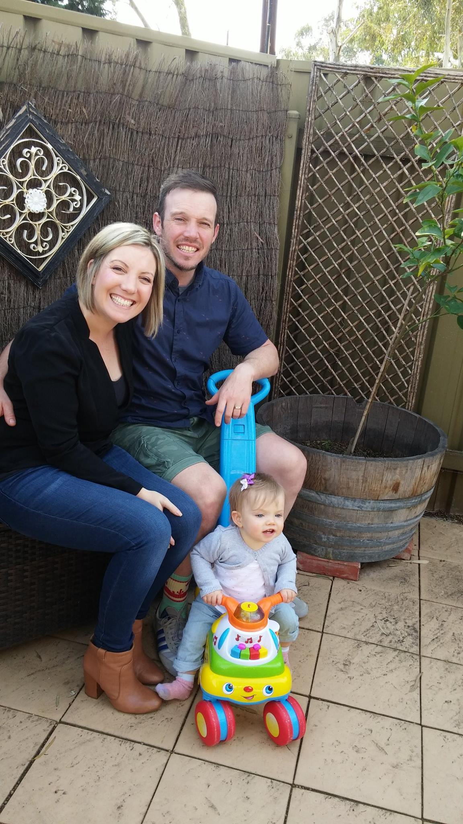
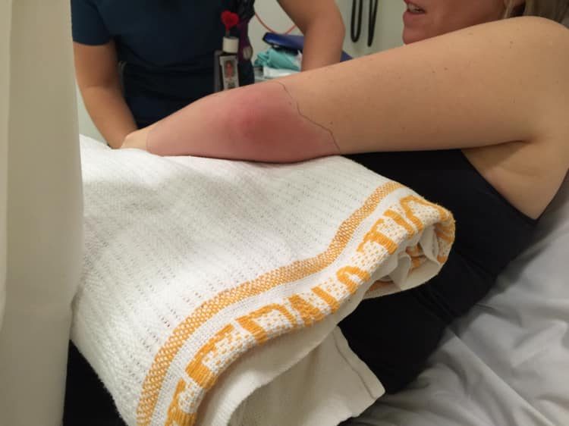
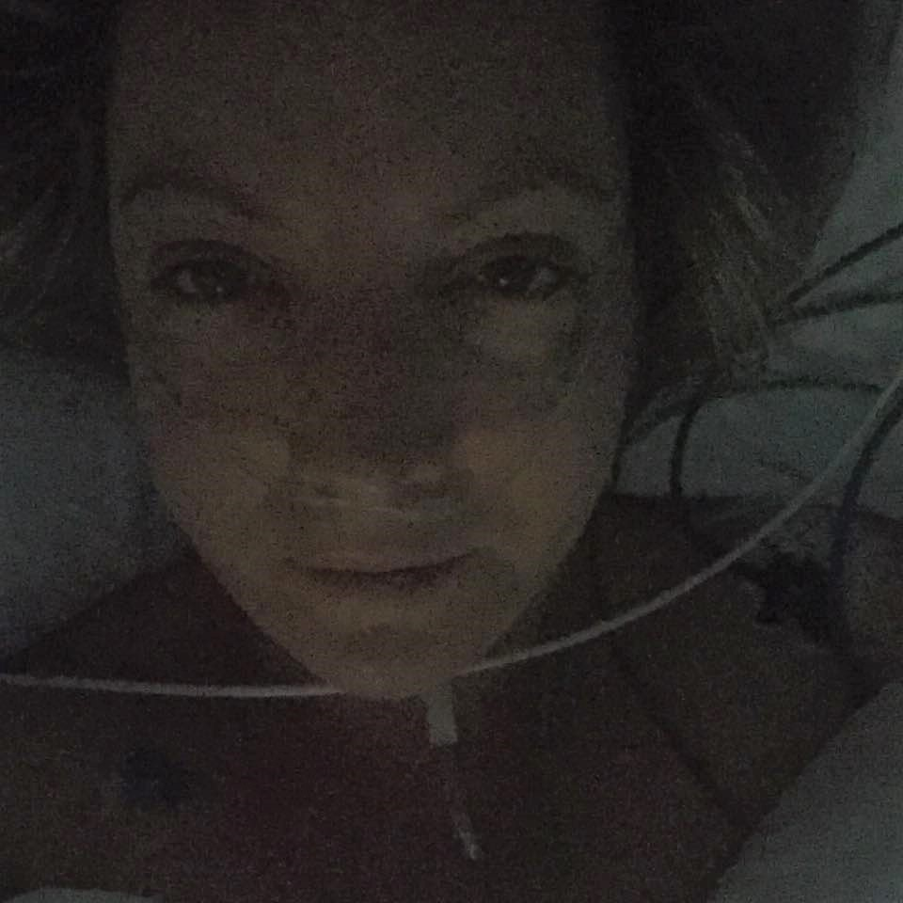
Fiona – a survivor’s perspective

Slide 14
Fiona – a survivor’s perspective (clinical timeline)
On arrival 7am – BP 100/60, HR 60, RR 20, SpO2 97%, temp 37.5, left elbow decreased movement, red & swollen
Diagnosis - Olecranon Bursitis. Analgesics for pain relief
10.53 admitted to EECU
11.15 IV Antibiotics Flucloxacillin
11.25 - BP 123/83, HR 94, RR 20, SpO2 97%, temp 37.3
12.20 - BP 98/60, HR 96, RR 20, SpO2 97%, temp 38.4. Given warm blanket for shivering & now hypotensive
Moved to resus & IVT commenced.
13.10 - Antibiotics changed to Cephazolin
15.10 - BP 96/63, HR 106, RR 18, SpO2 96%, temp 38.1
17.50 – ICU review. Not for ICU at this time. Encourage oral fluids. Accept SBP>90MAP>60 and HR < 135.
18.00 Ortho r/v – admit for olecranon bursitis traumatic v infectious, fast from midnight.
18.40 Obs pre-transfer to ward BP 97/60, HR 130, RR 18, SpO2 100%, temp 38. No urine output documented in ED. 3 Litres IVT administered in ED.
19.30 Arrival in ward. MET Call – BP 60/40. Moved to ICU immediately.
21.15 Ortho re-review – Olecranon swelling with re-accumulation of creeping cellulitis – septic shock

Slide 15
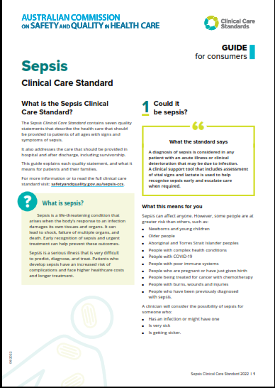
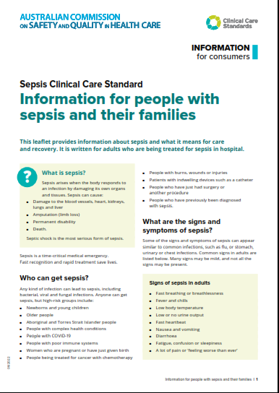
Consumer resources

Slide 16
Mary – a family/parent perspective
Preston’s story
What has changed in 19 years
What I think should be a priority going forward
How does the SCCS impact families
What are the gaps

Slide 17
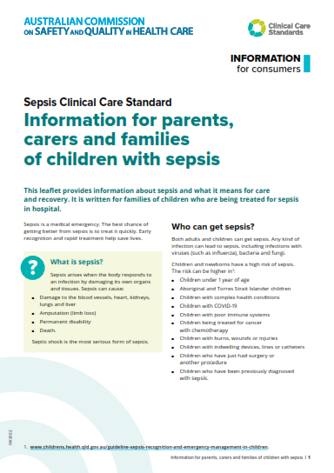
Consumer resource
What does it cover
Key points
How can it be used

Slide 18
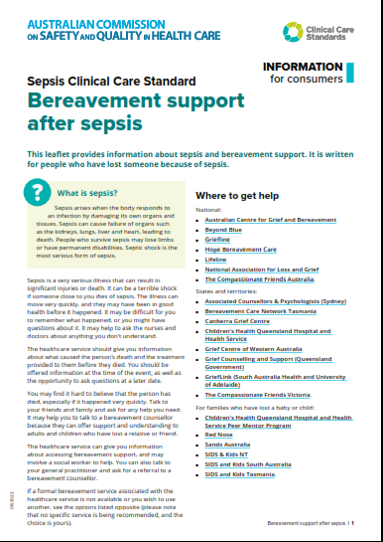
Bereaved families
Key points
How does it help consumers
Why its important to me
How can it be used

Slide 19
SCCS – Quality Statements 1 to 3
Early recognition, time critical management, antimicrobials
Prof Simon Finfer AO

Slide 20
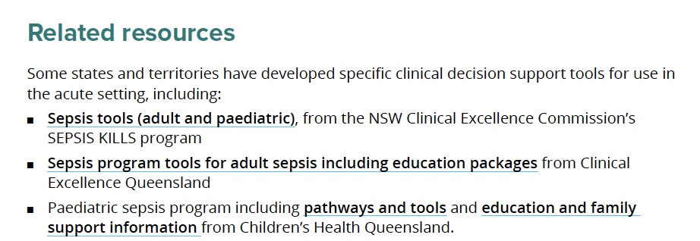
Sepsis recognition, escalation and intervention

Slide 21
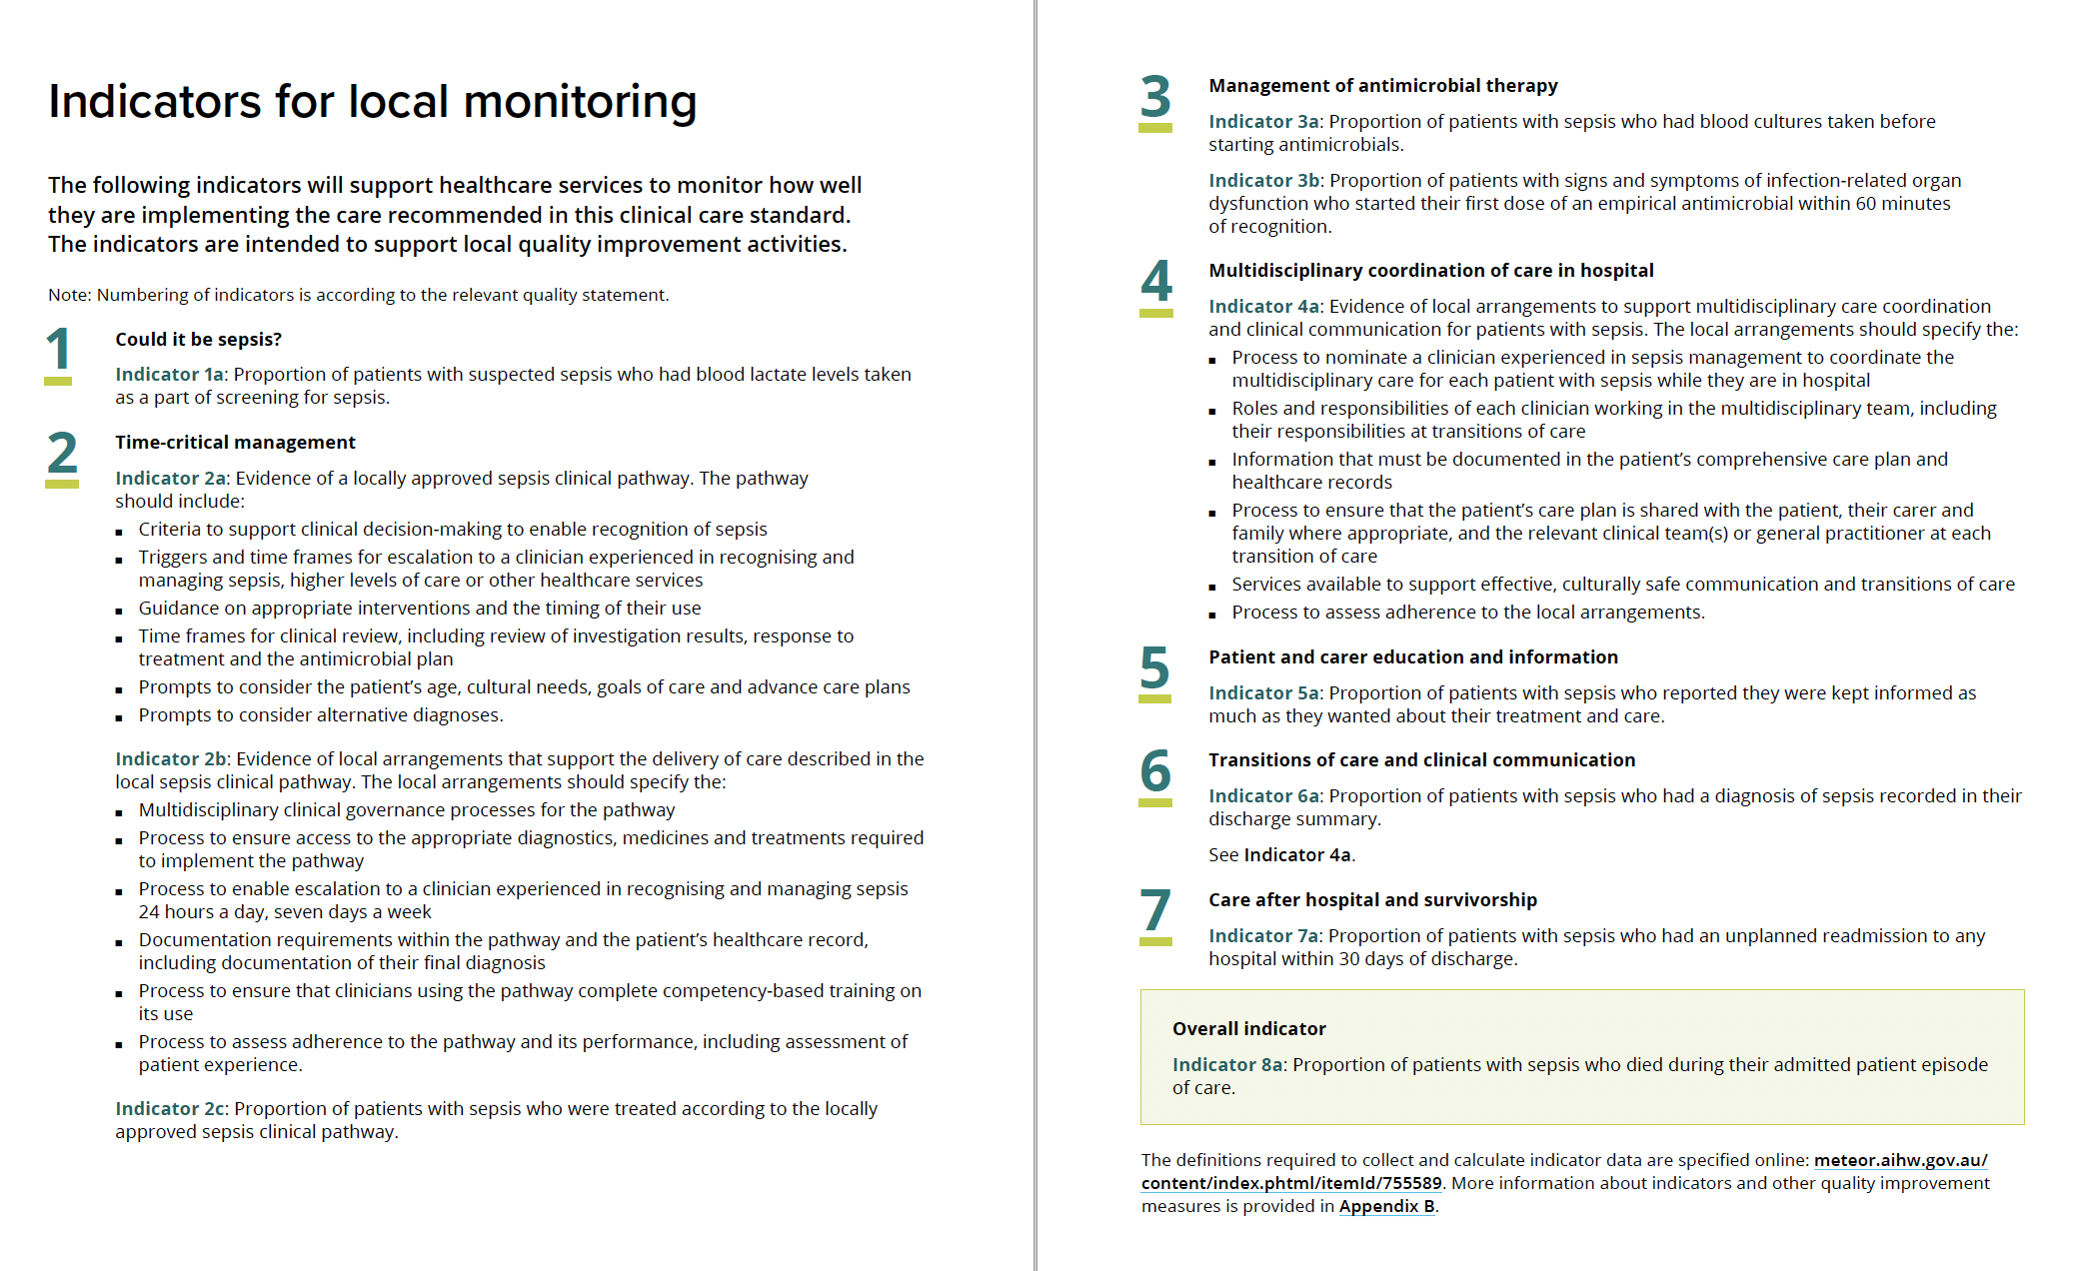
Clinical Indicators

Slide 22
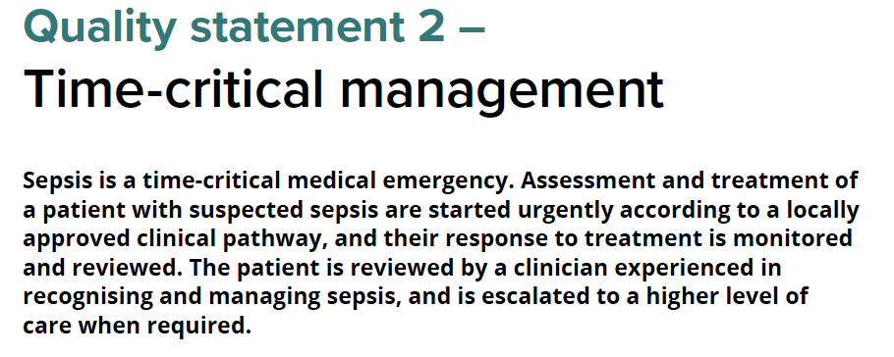
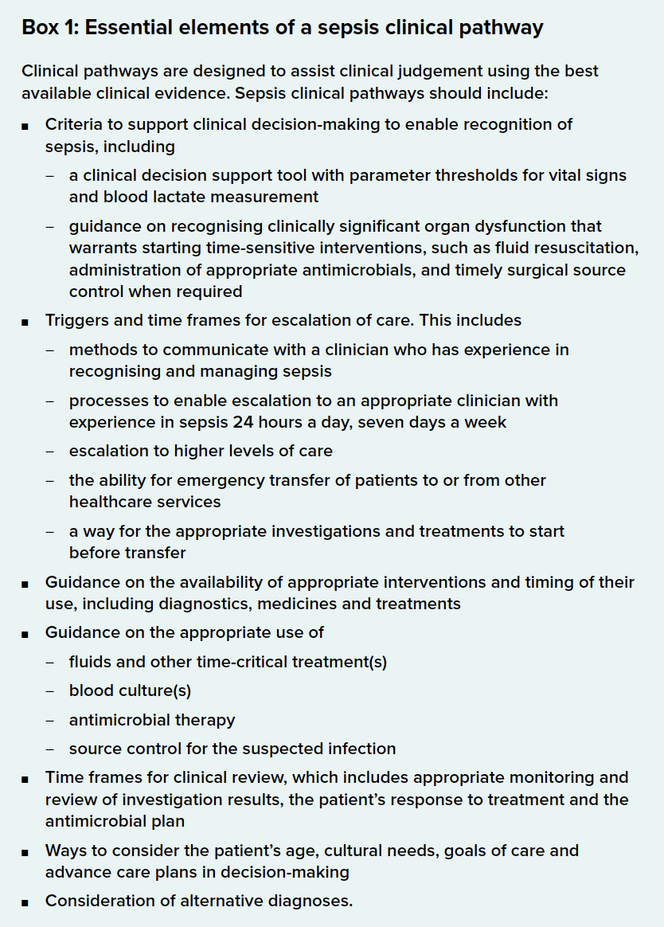
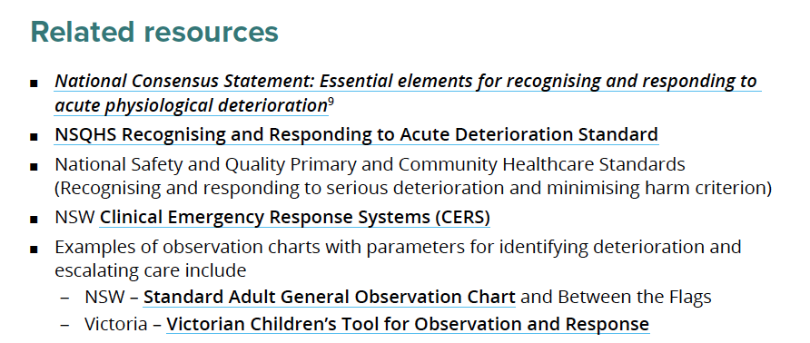

Slide 23
Clinical Indicators
2a: Evidence of a locally approved sepsis clinical pathway
2b: Evidence of local arrangements that support the delivery of care described in the local sepsis clinical pathway.
2c: Proportion of patients with sepsis who were treated according to the locally approved sepsis clinical pathway.

Slide 25
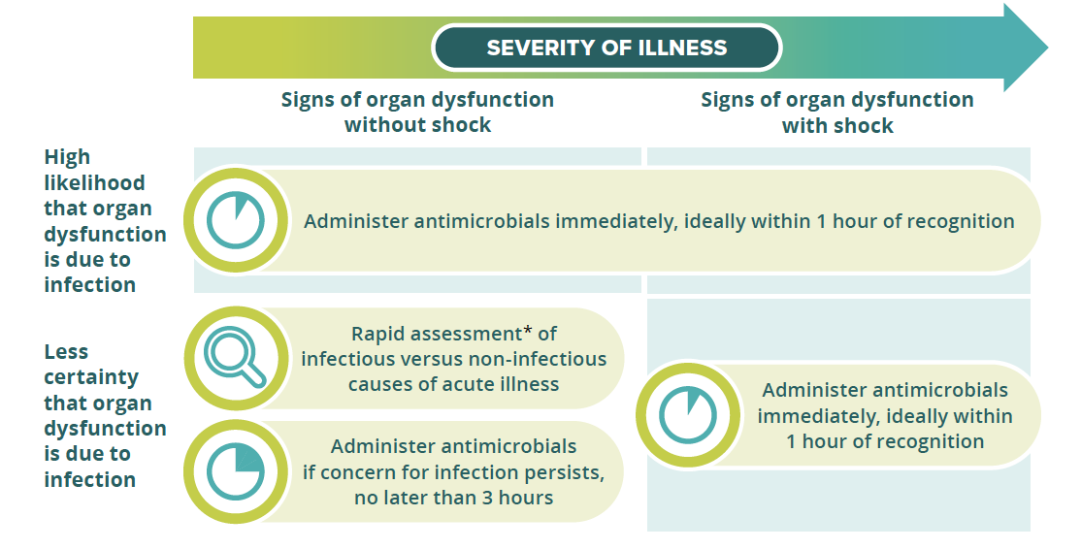

Slide 26
Prof Karin Thirsky
https://youtu.be/qv9Ks16_19w

Slide 32
SCCS – Quality Statements 4 to 7
Coordinated care, transitions of care and post sepsis support
Dr Brett Abbenbroek

Slide 33
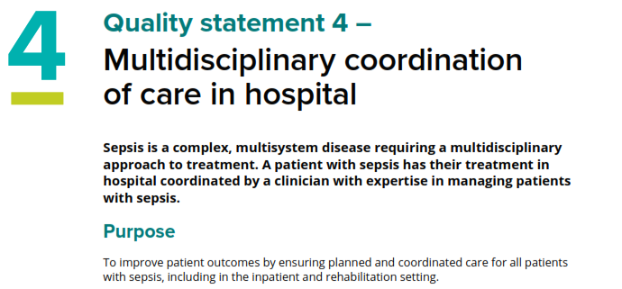
Implications:
designated lead doctor or nurse with expertise in sepsis will organise the care
coordinating clinician attend regular multidisciplinary meetings to optimise care
provide a policy and system framework that nominates and enables a central clinician
defined roles and responsibilities

Slide 34
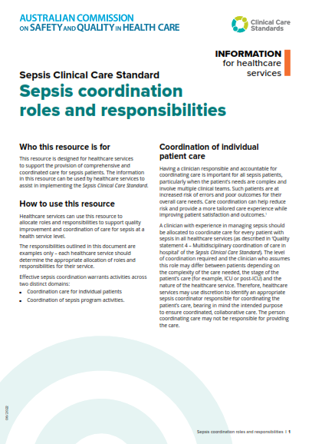
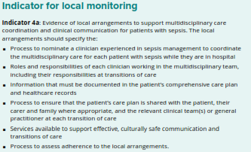
Resource:
Designated coordinator of care role description
Responsibilities
Sepsis management and coordination quality improvement program

Slide 35
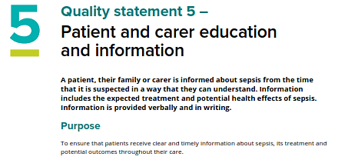
Implications:
diagnosis of sepsis and the type of treatment
systems in place to seek assistance if concerns are not being addressed
verbal and written information from the initial suspicion of sepsis
empower patients and carers to raise concerns
co-designed interpreted resources
on leaving hospital provide information and handover the management of the patients condition
clinician training

Slide 37
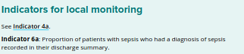
Implications:
suspected or probable sepsis flagged with a clearly documented handover and care plan
physical/psychosocial needs, their antimicrobial management plan and any infection precautions
structured handover
systems and supports are in place for clinicians to develop a comprehensive care plan

Slide 38
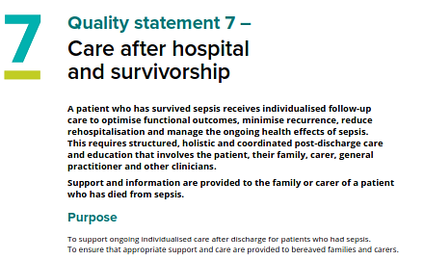
Implications:
suspected or probable sepsis should have a clearly documented handover and care plan
physical/psychosocial needs, their antimicrobial management plan and any infection precautions
structured written and verbal handover to primary care, provide a contact person
systems and supports are in place for clinicians to develop a comprehensive care plan

Slide 39
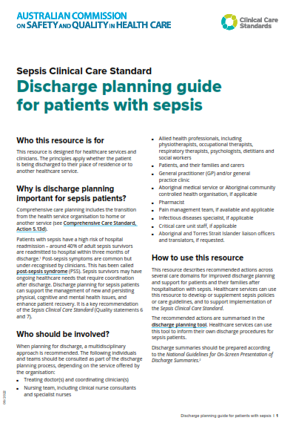
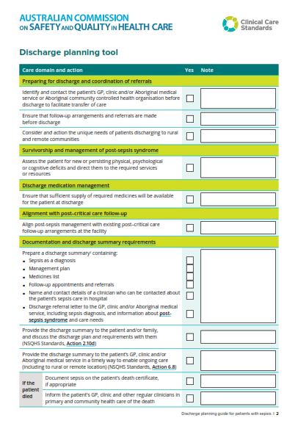
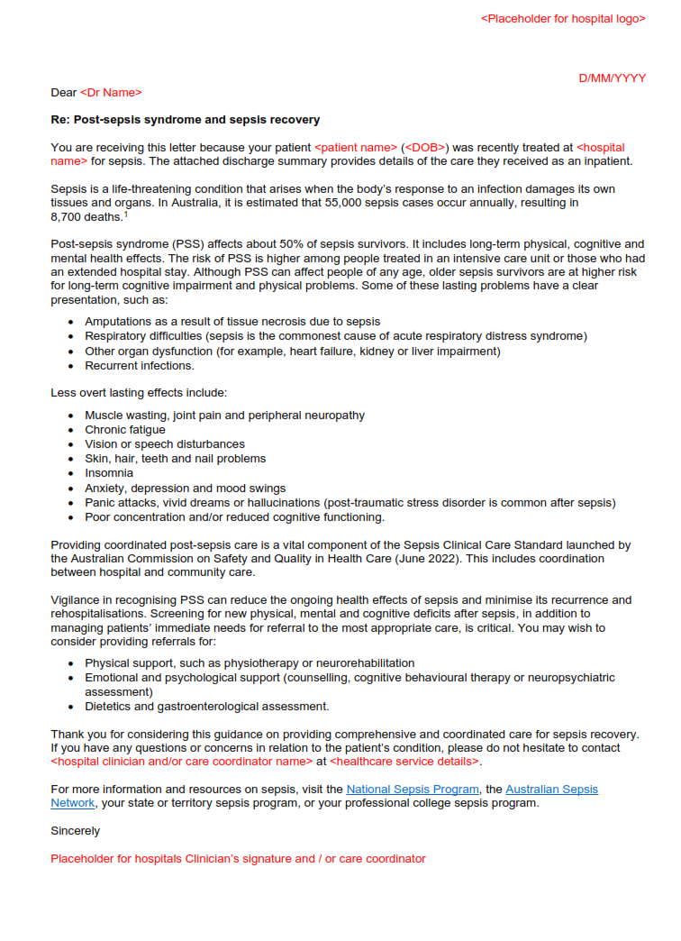
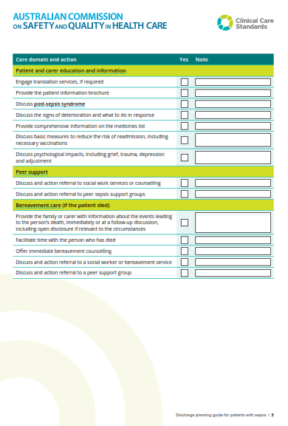
Prepare for discharge and coordination of referrals
Survivorship and management of post-sepsis syndrome
Discharge medication management
Alignment with post–critical care follow-up
Documentation and discharge summary requirements – GP letter
Patient and carer education and information
Peer support
Bereavement care

Slide 40
QLD CEC Paediatric Sepsis Support and Mentorship
Ms Meagan O’Keefe
Ms Alana English

Slide 41
Stopping Sepsis National Action Plan
5 Year Strategic Objectives
ASN Evolution
Prof Simon Finfer AO

Slide 42
The next 5 years ……

Slide 43
Other: Sepsis pathway in eMR, secure a physical premises

Slide 44
Stopping Sepsis National Action Plan – Top 12 - 5 Year Priorities

Slide 46
Launch
World Sepsis Day 13 September 2022

Slide 47
Thank you

