Slide 1
Sepsis
Clinical Care Standard
ASN Forum
25 August 2022

Slide 2

Acknowledgement of Country
Notes:
Gadigal people, Eora nation
Sepsis survivors

Slide 3
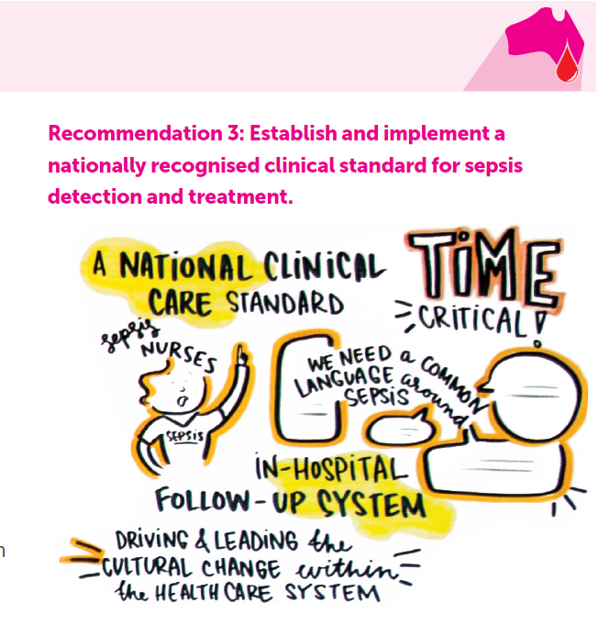
☑
Notes:
Pleasing to be able to stand up here as a representative of the ACSQHC and say that the Sepsis Clinical Care Standard is completed.
Honoured to be speaking about the standard at an Australian Sepsis Network Symposium at the George Institute – because without their strategy and advocacy, this standard may not have happened.

Slide 4
About the Commission
Leads and coordinates nationally
Funded by all Australian governments
National Health Reform Act (2011)
Formulate standards & indicators relating to clinical conditions
Advise Health Ministers on national clinical standards
Promote, support and encourage implementation
Monitor implementation and impact
Notes:
The Australian, state and territory governments initially established the Australian Commission on Safety and Quality in Health Care (the Commission) in 2006 to lead and coordinate national improvements in healthcare safety and quality.
The Commission is an agency of Federal Health, and was established as an independent statutory authority in July 2011 under the National Health Reform Act, alongside the Independent Hospital Pricing Authority (IHPA)

Slide 5
Clinical care standards
Up to 10 quality statements
Describe the clinical care a patient should be offered
Focus on parts of the patient journey which are quality improvement priorities or crucial to effective care
Are not clinical practice guidelines but are based on guidelines
Include indicators to allow monitoring

Slide 6

National Sepsis Program
$1.5m Department of Health funding (June 2020)
In partnership with The George Institute for Global Health
Improving sepsis recognition and awareness
Nationally agreed sepsis clinical guidance materials
Strengthening care for sepsis survivors.
Notes:
National awareness campaign materials
Literature reviews to support sepsis recognition and survivorship
Clinical Care standard
Medical Chart Review and Audit

Slide 7
Clinical care standard development
Evidence-practice gaps or variation
Recommended care vs current practice
Who/what/when
Implementable
Measurable
Actionable
Quality statements and indicators
Improve patient experience & outcomes
Evidence to support
Potential to reduce variation
Key components of care
(priority)
Variation
Safety and quality issues
Measurable
Notes:
The process of developing a CCS seek feedback from members to help us
Identify gaps between recommended care (from guidelines, evidence and recognised best practice/consensus), variation, safety and quality issues
Decide on scope – narrow or broad
Decide on key components (where is there potential to reduce variation, improve outcomes, improve patient experience)
Develop quality statements and indicators (make statements actionable and measurable through relevant indicators to encourage change)
Incorporated feedback in the draft document and will seek further advice from members today

Slide 8

Purpose of indicators
Tool for local health services to use to monitor implementation of the quality statements
Support local clinical quality improvement activities
Allow consistent monitoring, implementation and evaluation of quality statements
https://meteor.aihw.gov.au/content/index.phtml/itemId/755589
Notes:
Must measure the clinical practice specified in the quality statement
Good indicators are:
Valid (measure the intent)
Reliable (repeated results when collected by different people)
Feasible (data easy to collect)
Clear (definitions, data easy to interpret)
Actionable (quality improvement)

Slide 9
Stakeholders
Key informants
Board & sub-committees
States & territories
Clinical care standard
Health Chief Executives
Topic Working group
Public consultation
Professional and consumer orgs
National Sepsis Program
Notes:
TWG: Mix – geographical, multidisciplinary, gender-balanced. College / consumer organisation nominations
Consultative development:
Engage with jurisdictional clinical contacts early in development
Public consultation: professional colleges, peaks, jurisdictions, health services.
Commission’s governance: works with all governments and funding provided by states, territories as well as Commonwealth. Governance committees that include representation from states and territories can provide feedback this way (and ensures national relevance). Also means states and territories engaged prior to CCS release.
Request endorsement by key professional colleges.

Slide 10
Development process and TWG
Topic Working Group
Current guidelines
Public consultation
Commission governance including states and territories
Endorsement by key professional orgs
Notification of Health Chief Executives nationally
Launch
Implementation
Notes:
Clinical care standard developed based on
TWG advice
Best current evidence
Public consultation
Commission governance processes
Endorsement
Notification of Health Chief Executives nationally
Launch
Implementation
Review

Slide 11

National Safety and Quality Health Service Standards
Action 1.27: The health service organisation has processes that:
  Provide clinicians with ready access to best-practice guidelines, integrated care pathways, clinical pathways and decision support tools relevant to their clinical practice
  Support clinicians to use the best available evidence, including relevant clinical care standards developed by the Australian Commission on Safety and Quality in Health Care

Slide 12
Tools for assessment and monitoring
Indicator monitoring tool
Data collection and monitoring of indicators
Reporting at local level
Some analytics
Simple format
Self-assessment tool
Readiness to implement
Gap analysis
Local program development and implementation
Notes:
Both tools to support services
Complementary with each other
Complement local processes

Slide 13
Indicator types
Structure:
system characteristics
2a: Evidence of local arrangements for sepsis pathways
Process:
actions or activities (appropriateness)
Outcome: health outcome (effectiveness)
3a: Blood cultures before antimicrobials
3b: Antimicrobials within 60mins
7a: Readmissions within 30 days of discharge
8a: Proportion of patients with sepsis who died during their admitted patient episode of care.
Structure: system characteristics
Process: actions or activities
Outcome: achievement of health outcome (effectiveness)
Notes:
Achievable
Useful
Measurable
Risk-based
Not mandatory

Slide 14
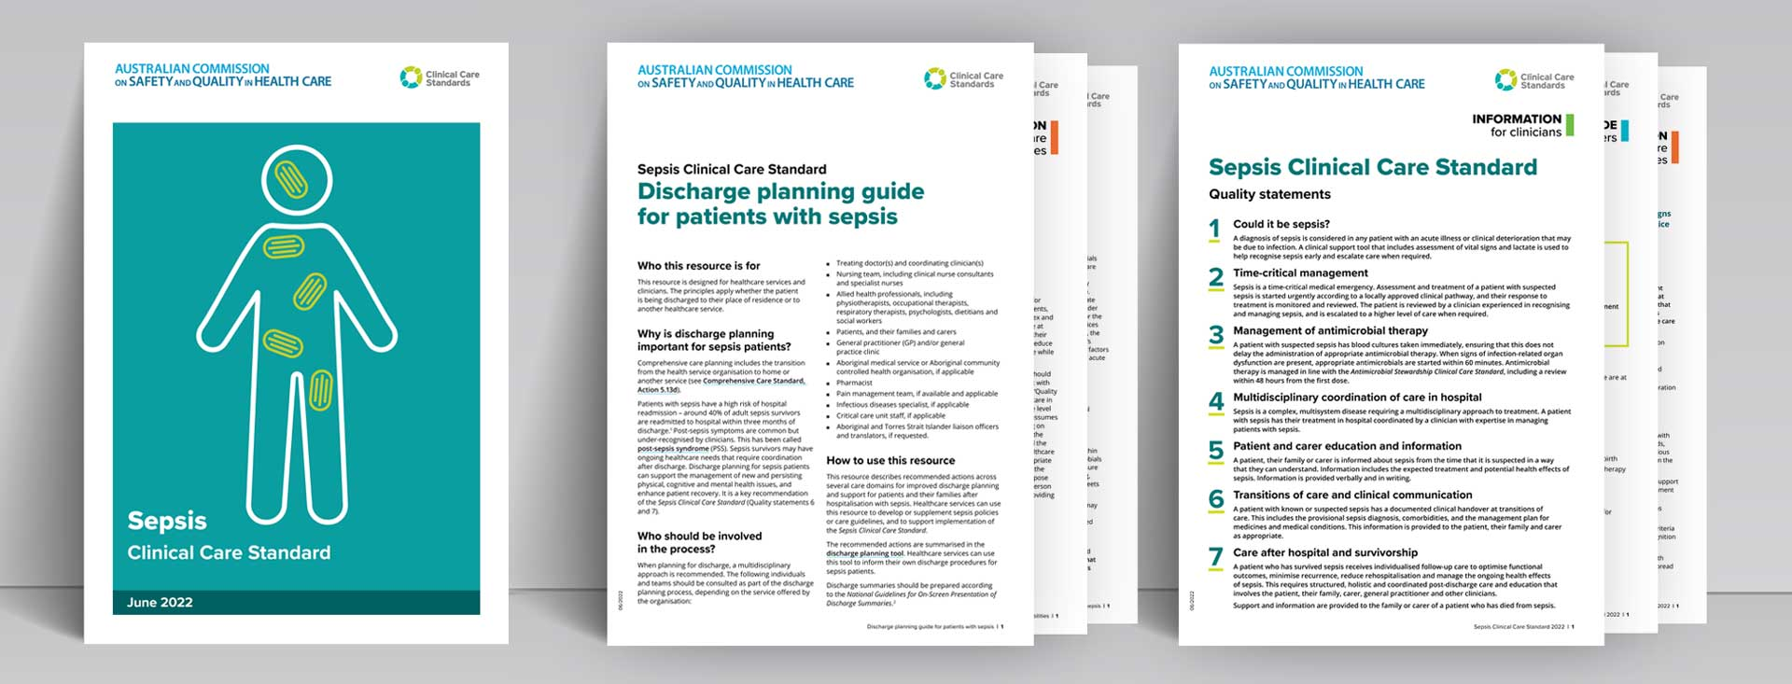
CLINICAL CARE STANDARD
PROFESSIONAL RESOURCES
CONSUMER RESOURCES
CASE STUDIES
Notes:
You can find all of this information on the Commission’s website along with an extensive range of resources.
As well as the clinical care standard there is supporting information for clinicians and healthcare services.
For consumers there are information sheets and links to useful resources.
The professional resources cover
Lactate and what it means
Antimicrobial access and sepsis boxes
Discharge planning and a template letter to GPs about post-sepsis syndrome
The role of a Sepsis coordinator.
We also have 3 Health Service Case Studies sharing the good work of teams around the country to give us food for thought. (These include
a ‘code sepsis’ alert incorporating best practice antimicrobial stewardship;
a sepsis program in a remote hospital serving Aboriginal communities;
and the innovative family peer support program for childhood sepsis survivors run by Queensland Health and led by Paula Lister.
And more to come in the weeks and months ahead – so stay tuned…

Slide 15
Quality Statements
1. Could it be sepsis?
2. Time-critical management
3. Management of antimicrobial therapy
4. Multidisciplinary coordination of care in hospital
5. Patient and carer education and information
6. Transitions of care and clinical communication
7. Care after hospital and survivorship
Notes:
The Clinical Care Standards includes 7 quality statements.
These cover the patient journey from diagnosis to discharge from hospital: ensuring that a patient presenting with signs and symptoms of sepsis is recognised early and receives coordinated, best-practice care so that the risk of death or ongoing morbidity is reduced.

Slide 16

Notes:
The George Institute for Global Health has partnered with the Commission to develop and implement the work of the National Sepsis Program.
And we have been supported in our development process by a number of organisations who have endorsed the final standard.

Slide 17

safetyandquality.gov.au/sepsis-ccs
Notes:
NB need to confirm URL

