Slide 1
QPSP Family Support Structure
Meagan O’Keefe, Advanced Social Worker, QPSP
Alana English, Advanced Social Worker, QPSP

Slide 2
Sepsis Clinical Care Standard
Sepsis phase​ | Quality statements​
CO-ORDINATED PATIENT andFAMILY CENTRED CARE​ | 4. Multidisciplinary coordination of care in hospital​
 | 5. Patient, carer family education and information​
PLANNING FOR CARE AFTERHOSPITAL​ ​ | 6. Transitions of care and clinical communication​
 | 7. Care after hospital and survivorship​
Notes:
As Brett has discussed, quality statements 4, 5, 6 and 7 of the clinical care standard are most relevant when it comes to family support.
Many of the resources and supports that are offered by the QPSP that I will speak about today, can be used by clinicians to meet these quality statements, and ultimately meet the unique needs of families impacted by paediatric sepsis.

Slide 3
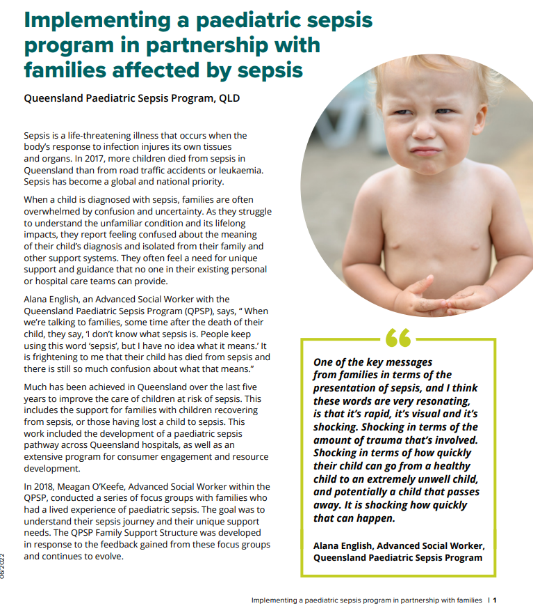

Notes:
The Commission has also developed several resources to support the implementation of the Sepsis Clinical Care Standard and a number of case studies that illustrate best practice and innovation in sepsis care.
I’d like to draw your attention to one in particular today: Implementing a paediatric sepsis program in partnership with families affected by sepsis - Queensland Paediatric Sepsis Program.
This case study summarises all the aspects of supports that I will be speaking to today and provides you with further links to the resources. It can be found on the Australian Commission for Safety and Quality in Health Care website.

Slide 4
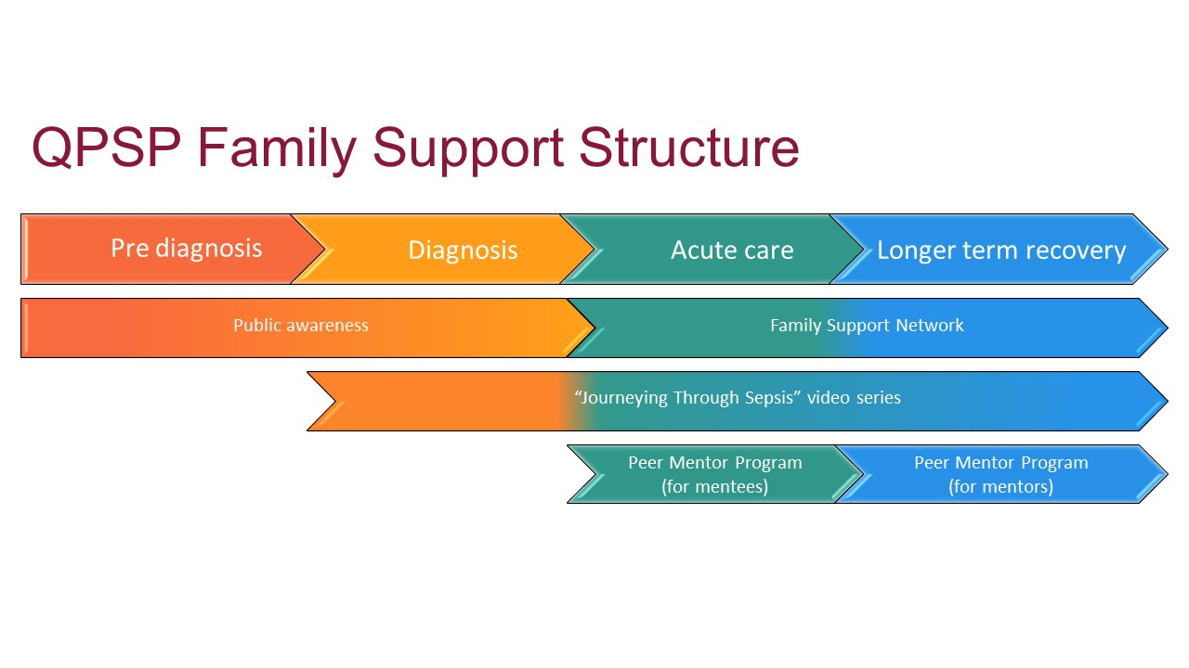
QPSP Family Support Structure
Notes:
To briefly bring you back a few years to give some further context to the development of the QPSP Family Support Structure- in 2018 in response to the ASN National Action Plan we completed a qualitative research study involving 11 Queensland families of children diagnosed with sepsis and managed in paediatric intensive care. This qualitative study explored the lived experiences of these families to better understand their sepsis journey and their unique support needs.
The themes and support needs identified by these families underpinned the development of the Family Support Structure. This is an evolving program that aims to provide key resources and supports for the child and family at all points of their journey, from the acute phase of diagnosis, to discharge, longer-term recovery and bereavement if their child did not survive. A key strength of the Family Support Structure is that it is co-designed by consumers and, in part, delivered by consumers. This design reflects the value that our program holds for the unique expertise and advocacy that consumers bring and ensures that all developments are created to best meet their identified needs. The various aspects of our program are multimodal, thereby increasing the opportunities for families to connect and process information at any time during the acute episode of sepsis or afterwards, from any location within Queensland, or for that matter across Australia and the world with regards to our website accessible resources.

Slide 5
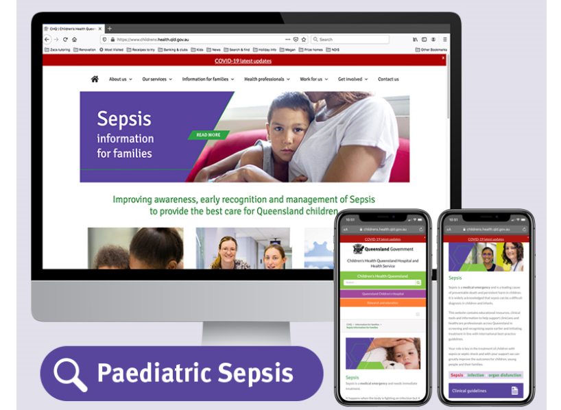

Public awareness and education- Website
Notes:
I will briefly touch on each aspect of the Family Support Structure, however both Alana and I are very open and keen for you to reach out for further discussion and information on any of what we have developed.
Firstly is the development of our website that has information focused for families, clinicians and research.
This is the Families tab of the website.
This landing page provides information about all of our established Family Support programs, and those that are in development.

Slide 6
Family Support Network
Receive information and resources about paediatric sepsis
Involvement in development of clinical and family educational materials
Involvement in Peer Mentor Program
Involvement in sepsis focused media opportunities
Involvement is paediatric sepsis research
Receive updates about QPSP developments
Opportunities to share their story
Notes:
We have also established a Paediatric Sepsis Family Support Network. The focus of this network is to create an opportunity for connection within the sepsis community and for active participation in our response to managing sepsis at all points of the healthcare journey. Families can easily register through our website, or through scanning the QR code on various flyers that we have developed. And this registration gives them access to any or all of the options listed.

Slide 7
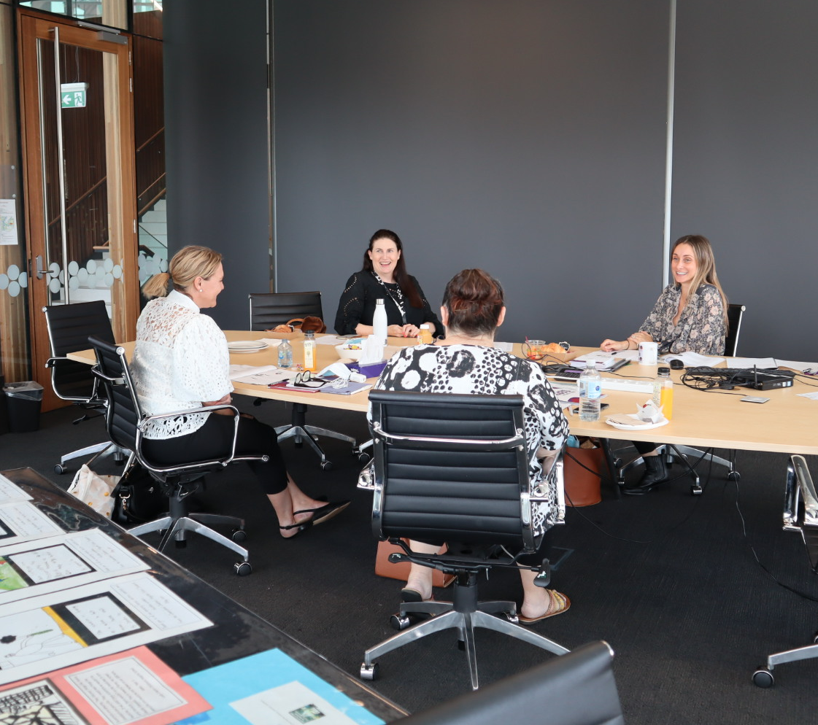
Peer Mentor Program
“And you just want to talk, and your friends try to help, and your family tries to help,
but you just want to talk to someone who goes
‘I get it, I get it’.
Even just sitting here I just, I feel like I’m not the only one,
for the first time in two years”
Notes:
A key theme that came from our research was the extreme isolation families experienced in having a child critically unwell with, and potentially having died from, a condition that they had a limited understanding of or limited support around. And how they were desperate for connection throughout the entirety of their childs’ illness, recovery, or death, with another parent who had been through what they were going through, and who could provide the unique support and guidance that no one in their existing or hospital support networks appeared able to provide. They wanted to be connected with their peers.
And so, we took the opportunity to co-design the world first paediatric sepsis specific peer mentor program.
This program provides families with a child diagnosed with sepsis, both surviving or bereaved, an opportunity for validation and normalisation of their experience by connecting them with a family member whose child was diagnosed with sepsis more than two years ago.
Led by myself and Alana as Advanced Social Workers, the Program was co-designed by consumers and is delivered by consumers, with input from key stakeholders including The Australian Centre for Social Innovation.
Our peer mentors are parents and carers who have first-hand experience with the challenges faced by families with a child newly diagnosed with sepsis and hence can assist them in navigating this experience. They receive extensive training and ongoing supervision from Alana and myself.
The PMP can be offered to any family within Qld and families can self-refer by registering on our website.

Slide 8
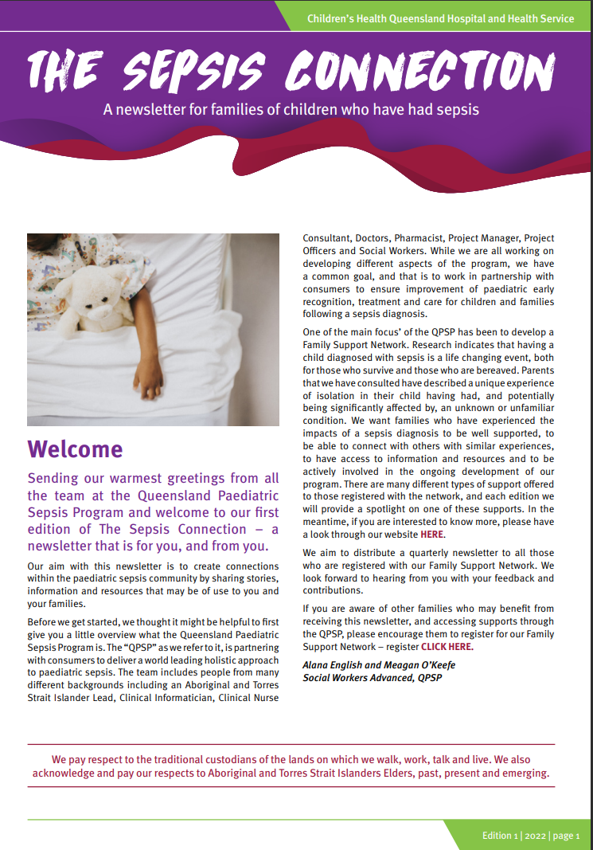
Newsletter
Notes:
We have also developed a quarterly newsletter “The Sepsis Connection”.
In each edition we share updates from the overall QPSP, we spotlight an aspect of the family support structure, provide information about research projects and opportunities to be involved, and one of our family’s shares their child’s story of their journey with sepsis. We also discuss a topic of interest for families, such as grief and loss and advocacy, with the aim of sharing relevant information and providing an opportunity for further discussion of these topics with family and friends.

Slide 9
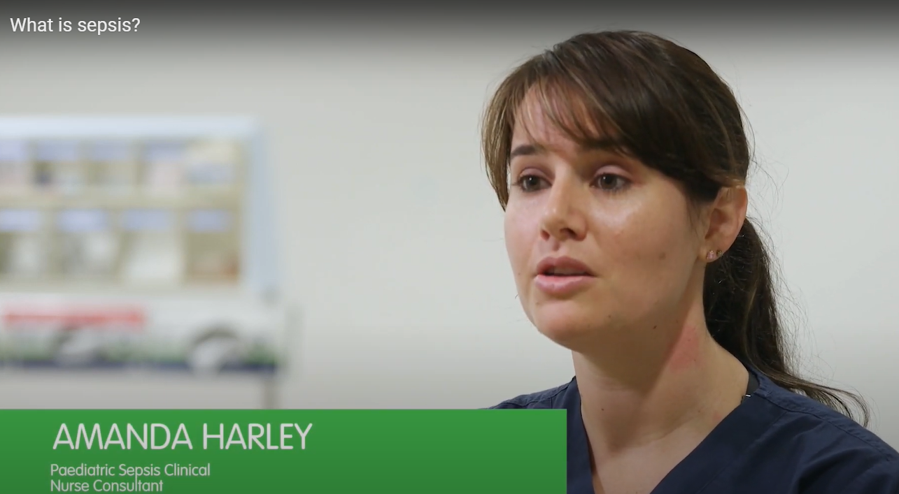
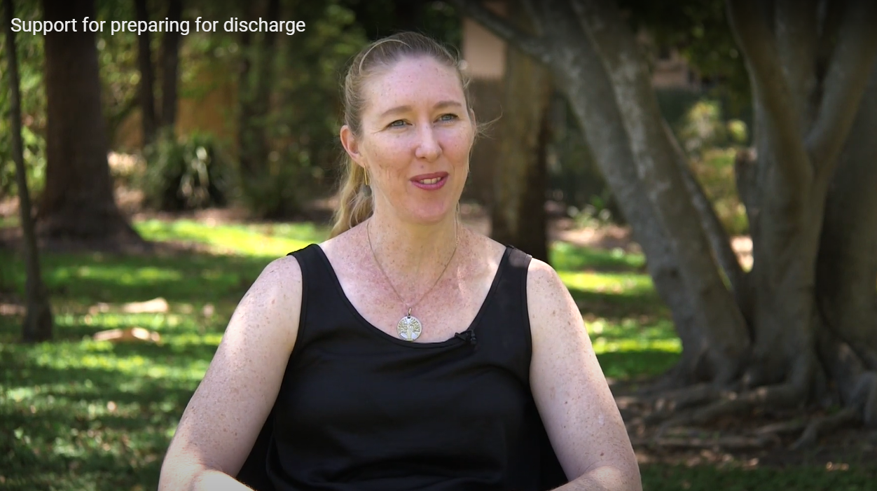
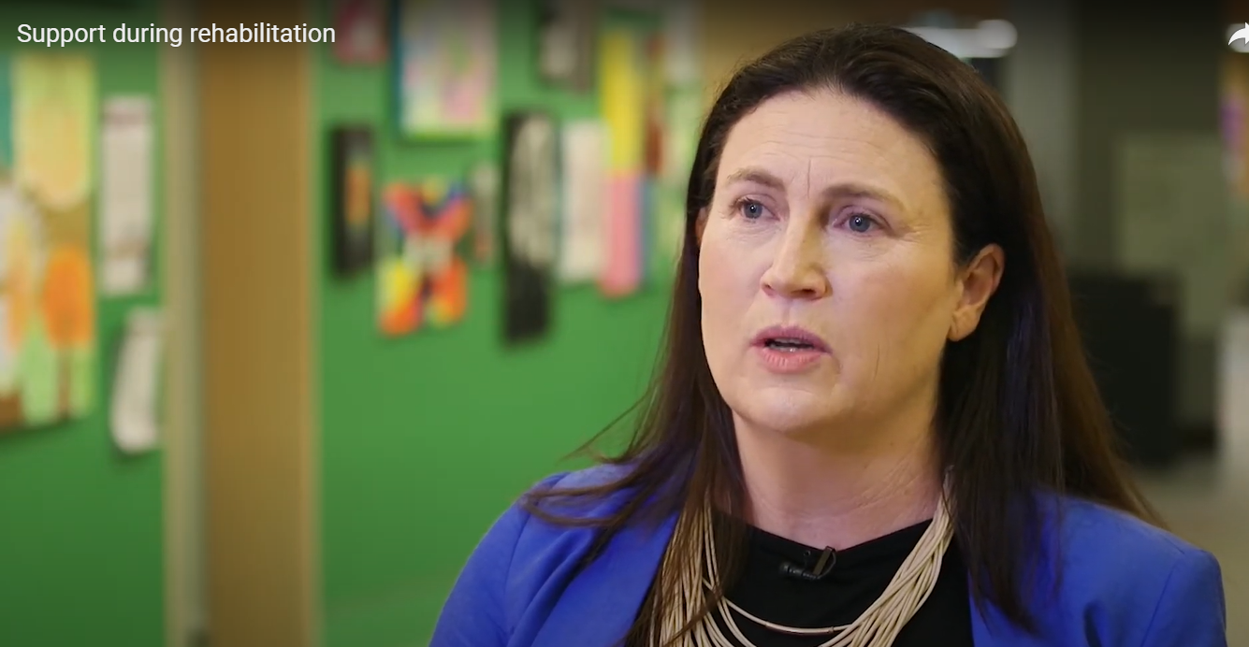
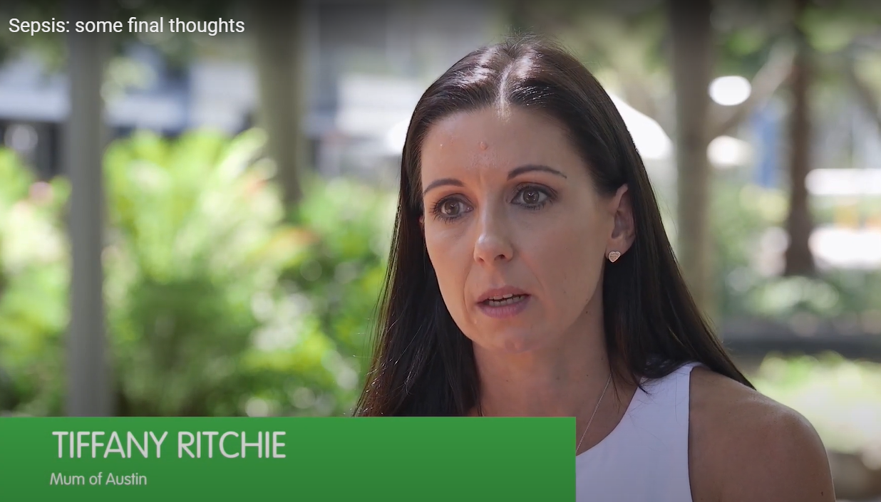
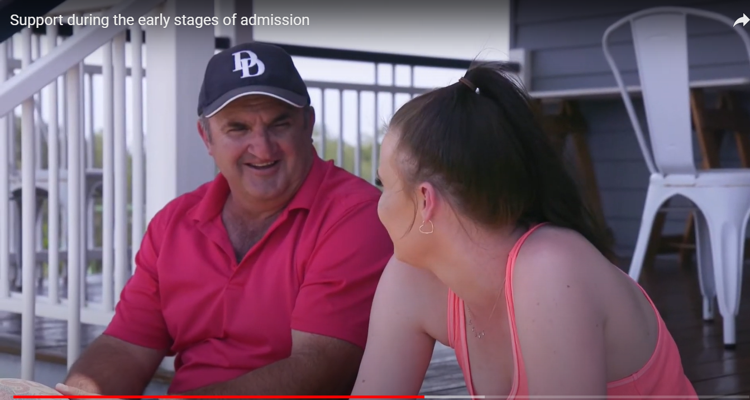
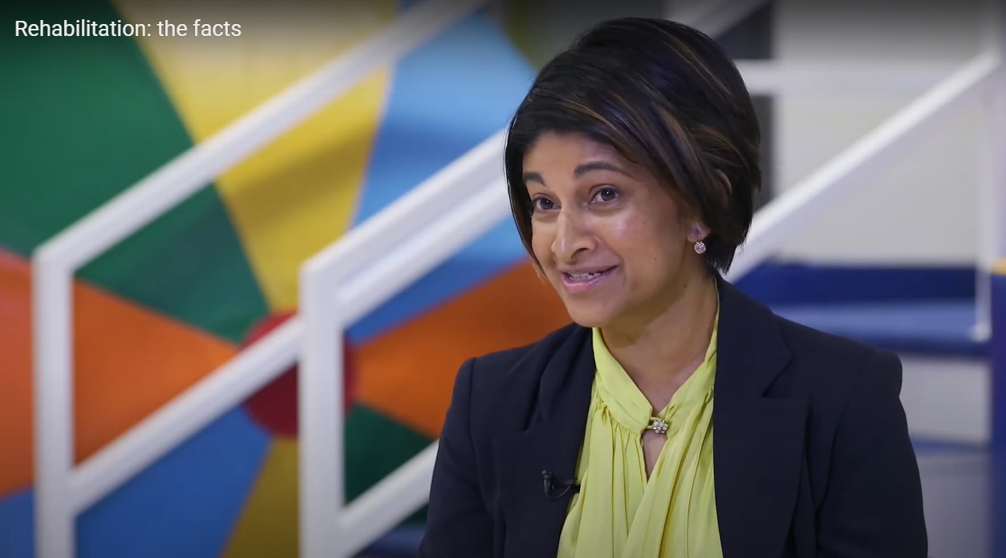
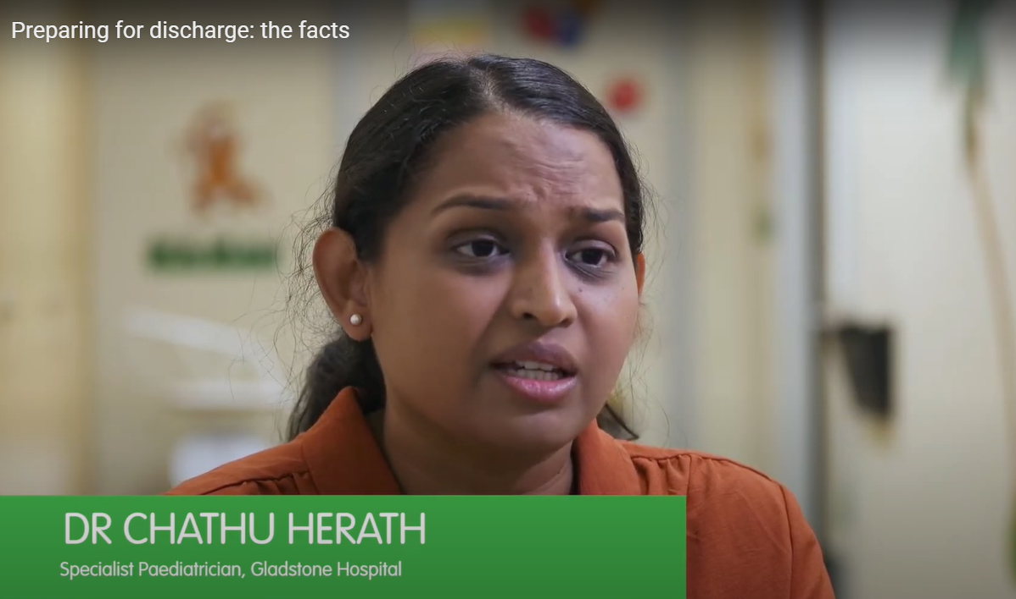
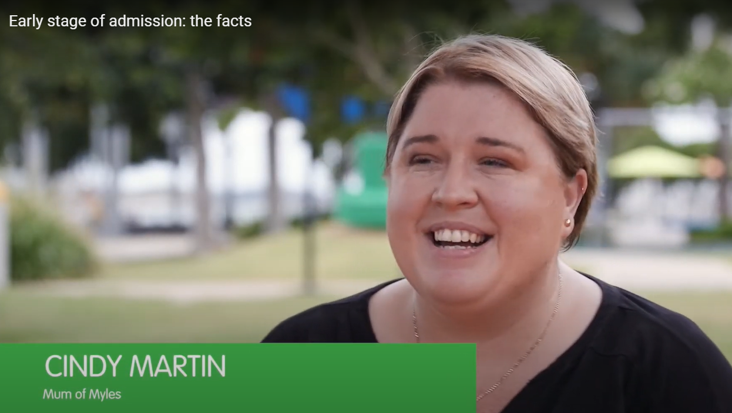
‘Journeying through Sepsis” Video Series
Notes:
The Journeying through Sepsis video series was developed in response to direct feedback from families indicating the need for consistent and timely education. The 8 part series aims to support families by providing information and guidance on each stage of their child’s hospital journey – from initial diagnosis through to intensive care, rehabilitation and support after discharge. The key messages are provided primarily by families (who have had a child diagnosed with sepsis) and key clinicians working in this specialist area. The four families within the videos have children of a range of ages and are from metro and rural areas within QLD. We ensured that their lived experiences are forefront in the videos, validating the real experience of the burden of sepsis for families.
You can direct families with a child with sepsis to these videos via our website, encourage them to view them and use these as a starting point for ongoing discussions with their primary health care team. Clinicians can view the video series to increase knowledge about sepsis, the burden of sepsis on families and sepsis resources and supports.

Slide 10
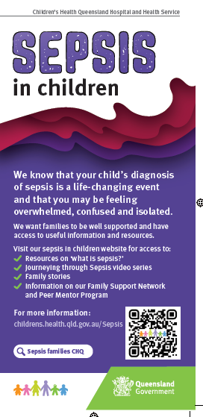
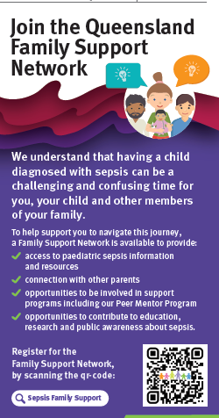
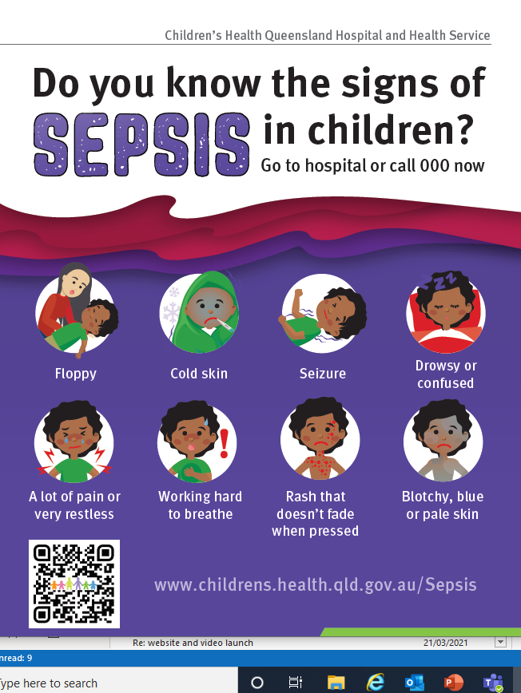
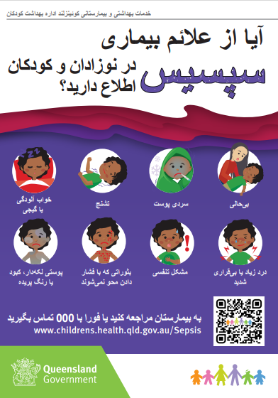
Resources for families
Notes:
We have developed a range of virtual and printable resources and we are adding to these all the time. These can all be accessed from our website.
The resources have been codesigned with our consumers and clinicians and have been translated into several different languages. Following consultation with CALD stakeholders these languages were determined based on families from these culturally diverse origins facing the most barriers to accessing healthcare in Australia.

Slide 11
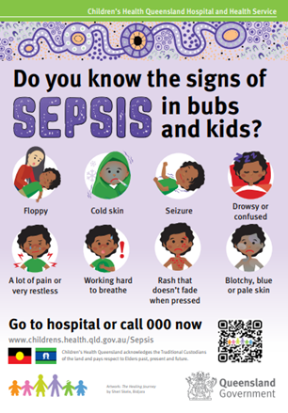
ATSI_paediatricsepsis@health.qld.gov.au
Aboriginal and Torres Strait Islander Families
Notes:
Within the QPSP we aim to consider and meet the unique needs of Aboriginal and Torres Strait Islander families. We know that Aboriginal and Torres Strait Islander children reside in greater proportion in rural Queensland and are therefore likely to be some distance from a tertiary hospital. We are also aware that Aboriginal and Torres Strait Islander children have a higher incidence of life-threatening sepsis requiring ICU admission and are particularly vulnerable to poor outcomes from sepsis.
We have an appointed ATSI Project Officer, Karen and she can be contacted at this email address. Karen has been making connections with local community members, educating and raising awareness about sepsis and developing a range of resources targeted at A&TSI families. Karen is keen to engage more clinicians across Qld to support them in supporting families of ATSI descent.

Slide 12
Paediatric Post Sepsis Model of Care
A state-wide model of care that:
includes interventions proven to be effective in minimising the impact of post sepsis syndrome
meets the needs of families from diverse backgrounds
covers the continuum of sepsis care, including bereavement
provides appropriate care across sectors, services, the state
locally based
in partnership with consumers
Interested in being involved in a focus group? Contact Alana.English@health.qld.gov.au
Notes:
We know that sepsis is a “life changing and disability inducing event” and that many children diagnosed with sepsis experience long-lasting physical, cognitive and psychological effects. And yet there is an overall lack of evidence regarding interventions to support recovery after sepsis, improve quality of life and to reduce ongoing morbidity.
With an ongoing aim to reduce the overall burden of sepsis on children and families and increase awareness for clinicians of the long-term impacts of sepsis, we are working on developing a post sepsis state-wide model of care. Multiple online and face to face focus groups and surveys will be used to explore families and clinicians’ experience of sepsis following discharge from hospital, and the perceived gaps in service. Recommendations for the development and implementation of a model of care that identifies key resources, stakeholders and supports for all families affected by sepsis, across Qld, will be developed from the findings. We need to ensure that this model of care includes interventions proven to be effective in minimising the impact of post sepsis syndrome, covers the continuum of sepsis care, including bereavement, and provides a coordinated, consistent and equitable approach for all families.
Please contact Alana English if you are interested in participating.

Slide 13



What can you do?
Educate
Inform
Connect
Notes:
In summary I ask you to consider three actions regarding how you can understand and meet the needs of families impacted by paediatric sepsis.
Educate yourself further on the resources I have discussed today- either through the case study available on the commission website or by accessing the QPSP website directly. As I also mentioned earlier please feel free to reach out to Alana or I should you wish you discuss any aspects of the family support structure in more detail or if you have any questions.
Inform colleagues and families you work with of the resources that have been developed and are available for use.
And most importantly, connect families you are working with with these supports

Slide 14
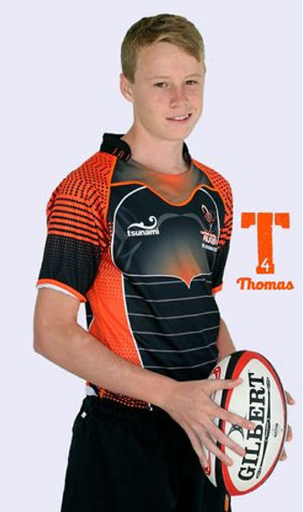
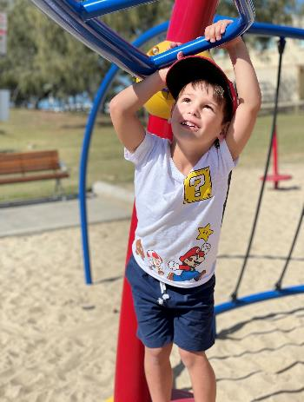
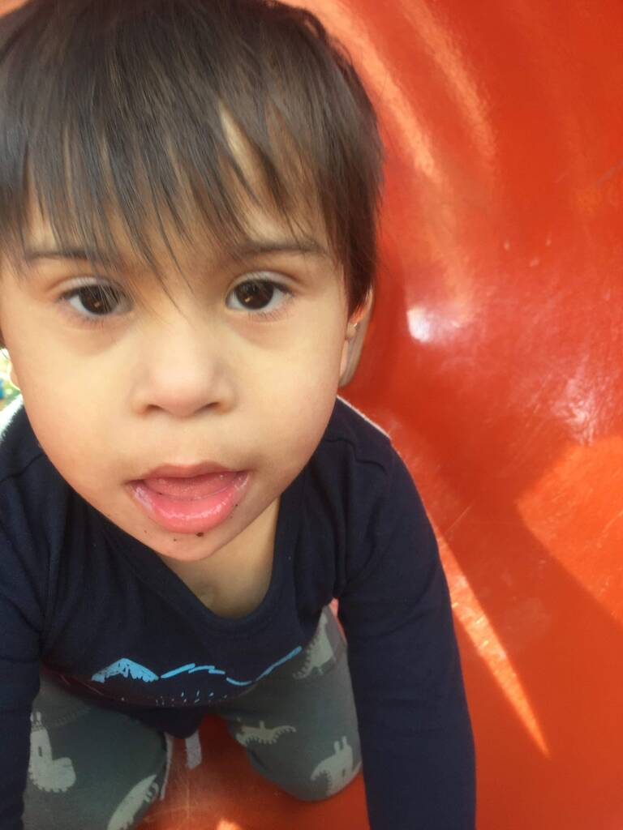
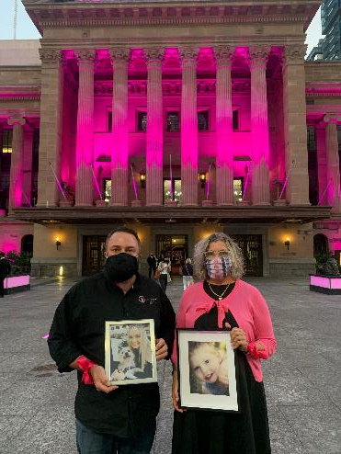
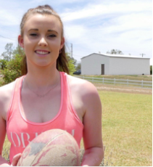
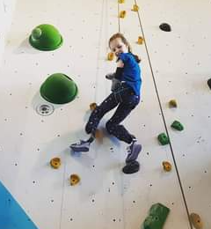
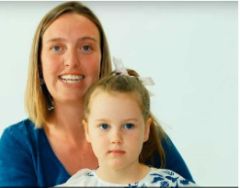
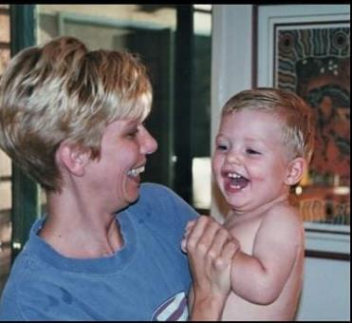
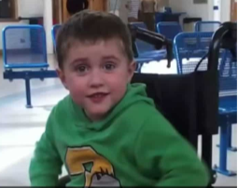
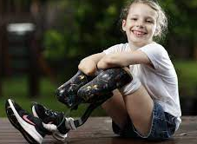
CONTACTS:
Meagan.OKeefe@health.qld.gov.au Alana.English@health.qld.gov.au
Notes:
As I hope I have demonstrated today our families that we work with within the Queensland Paediatric Sepsis Program are at the centre of all that we do. I would like to finish today with the most sincere thank you to each and every family impacted by paediatric sepsis who have shown bravery and vulnerability in guiding us to create a program that we know will change the paths of future families for the better. Thank you.

